Slide 1
Welcome to NSG 521
Fundamental Concepts & Health Assessment

Slide 2
Agenda
Faculty Introduction
Syllabus Review
Assignment Review
Important Information
Course Content

Slide 3


Faculty
Course Lead: Dr. Christina Nelson
Instructors:
Dr. Noella Fourman
Dr. Heather Gregg
Dr. Kellie Soles
Notes:
Find your section’s assigned instructor on the “your instructor” tab of the main page of the course canvas shell. Go straight to your section’s faculty for any questions/ concerns. They will escalate as needed.

Slide 4


Canvas Tips
Notes:
Be sure to read ALL announcements. They will include a lot of vital information.
Turn on course notifications so you get emails of announcements.
Modules will take you to all the content on canvas. Each week may be different in terms of sherpath or assignments so review each week.
Grades are listed here. There may be random scores for items like dosage calculations.

Slide 5

Syllabus
Go to Resources – download/ print syllabus.
Check off assignments/ lessons as you go.
Plan ahead for tests.

Slide 6
HESI Exams
Three HESI exams
Week 6 : Units 1-5
Week 11: Units 6-10
Final: Cumulative
Proctor U Assignment
Compatibility Screen Shot
Screen shot of scheduled time – be sure to
NOT OPTIONAL.
HESI Remediation
For exams 1 and 2 only.
EVERYONE must turn it in.
Due the week after the exam.
Links will be sent out prior to exam.
Conversion score in syllabus.
Use Herzing email

Slide 7
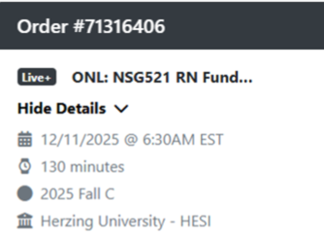
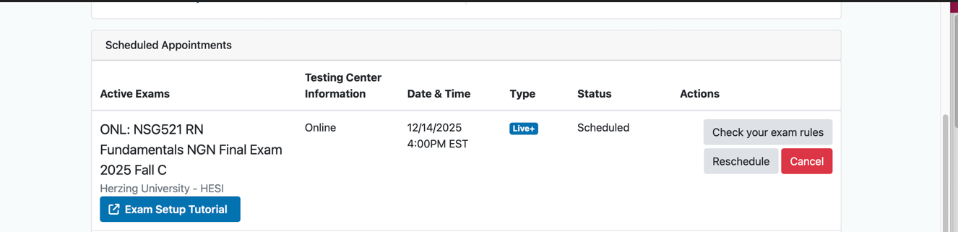
Proctor U Scheduling
Notes:
Example of scheduling screen shots

Slide 8
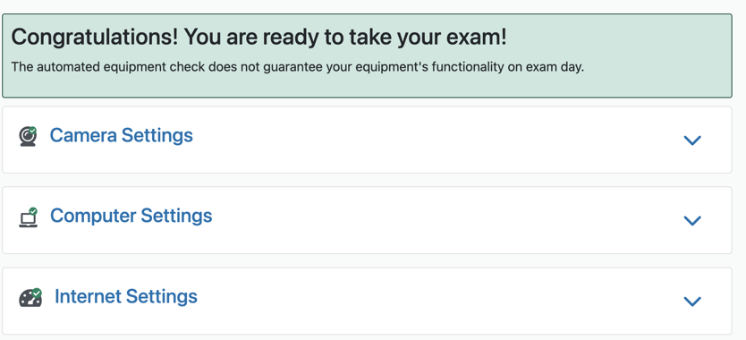

Proctor U Compatibility
Notes:
Compatibility Examples

Slide 9
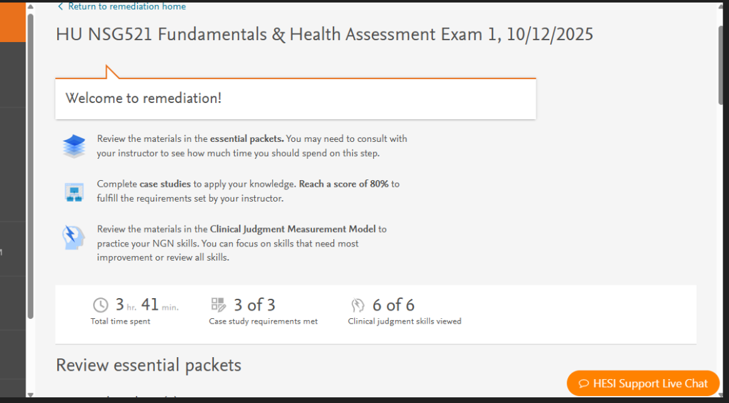

HESI Remediation
Notes:
EVERYONE must do the remediation no matter the score.
Due one week after HESI and MUST be turned into the canvas shell
Screenshots must have your name

Slide 10
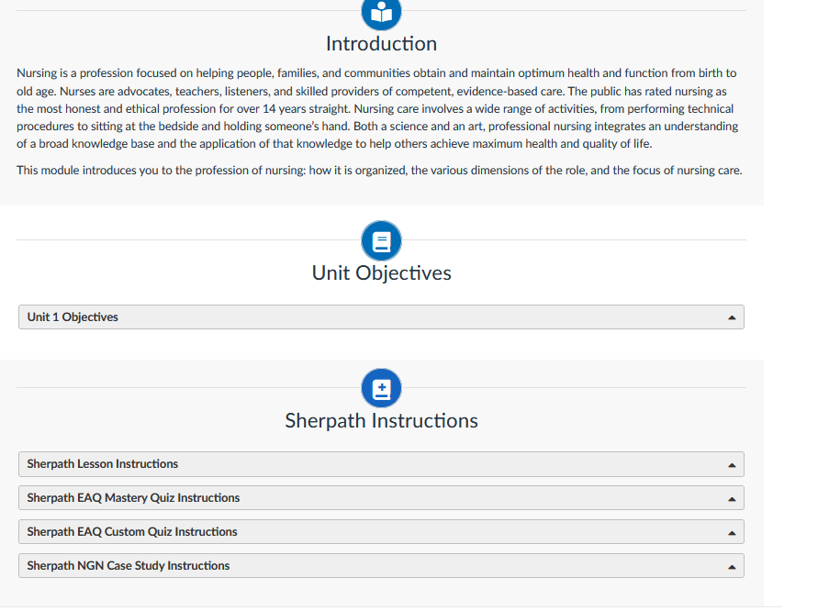
Sherpath
Lessons
Worth 10 points.
May take multiple times.
EAQ
25 questions
Can only take once
Can create your own
Mastery Quizzes
Have to hit the assigned mastery level – may take 10 questions, may take 70.
Only may take once.

Slide 11

Dosage Calculation Exams
Must obtain 80% on one of three to pass the course.
If you get 80% or higher you do not need to take additional tests in this course.
If you do not pass exam 1. There is a suggested remediation. Retake in week 9.
If you do not pass exam 2 you MUST remediate AND have approval from the program chair.
If you do not take a test, it is considered forfeited – unless there are extenuating circumstances.
You may use a standard calculator and a small white board that fits the screen for the exam.
Notes:
Access the exams only through the Module.
Do not access the exam from the To Do List or the name/list in the gradebook.

Slide 12
Test Problems?
Common Issues
Pay attention to am/pm.
Be sure to complete all required testing.
Do not wait until the last minute.
Review the catalog for makeup exams and grade appeals.
Technical Issues
You will need a Herzing IT (and other platform as necessary) ticket. MUST BE CREATED DURING THE TIME THE EXAM WAS OPENED
Extenuating Circumstances
Will need documentation.
Review syllabus and catalog for permissible issues.
Message your faculty and student services as soon as possible.

Slide 13
3 Requirements for Successful Completion of 521
80% or higher in course.
Pass 1 of 3 dosage calculation tests.
Successful completion of the head to toe physical at intensives.

Slide 14
Questions?

Slide 15
Fundamentals of Nursing,
Unit 1

Slide 16
Nursing as a Profession (1 of 2)
To act professionally, you will:
Use critical thinking skills
Administer quality patient-centered care
Be responsible and accountable
Understand the scope of professional nursing practice and how nursing influences the lives of your patients, their families, and their communities.
Notes:
We are a service line. A lot of customer service. Have a lot of autonomy. Make decisions based on evidenced-based practice.
What does your social media say about your professional status. Any prior legal issues can cause issues with getting your nursing license.

Slide 17
Nursing as a Profession (2 of 2)
Health care advocacy groups the importance of the role nursing plays in a nations’ health care
Robert Wood Johnson Foundation (RWJF)
Future of Nursing: Campaign for Action
Catalysts for Change: Harnessing the Power of Nurses to Build Population Health in the 21st Century
Notes:
Advocacy groups that help empower nursing.

Slide 18
Science and Art of Nursing Practice
Nursing requires:
Current knowledge and practice standards
Insightful and compassionate approach
Critical thinking and clinical judgment
Benner’s stages of nursing proficiency:
Novice
Advanced beginner
Competent
Proficient
Expert
Notes:
ANA regulates some of the scope of practice

Slide 19
Scope and Standards of Practice
Nursing definitions
01
American Nurses Association (ANA)
International Council of Nurses (ICN)
Nursing: Scope and Standards of Practice
02
Standards of Professional Nursing Practice
Standards of Professional Performance
Code of Ethics
Notes:
They gives us standards of practice.

Slide 20
Professional Responsibilities and Roles
Autonomy and accountability
Caregiver
Advocate
Educator
Communicator
Manager

Slide 21

Career Development
Clinician
Advanced Practice Registered Nurses
Clinical nurse specialist
Nurse practitioner
Certified nurse-midwife
Certified registered nurse anesthetist
Nurse Educator
Nurse Administrator
Nurse Researcher
Notes:
Nurses:
Respond to needs of patients
Actively participate in determining best practices
Knowledge of the history of the nursing profession increases your ability to understand the social and intellectual origins of the discipline.

Slide 22
Florence Nightingale
Established first nursing philosophy based on health maintenance and restoration
Organized first program for training nurses
First practicing epidemiologist
Improved sanitation in battlefield hospitals
Practices remain a basic part of nursing today

Slide 23
Twentieth Century
Movement toward scientific, research-based practice and defined body of knowledge
Nurses assumed expanded roles
1906: Mary Adelaide Nutting was instrumental in moving nursing education into universities
1920s: Nursing specialization began
1990: ANA established Center for Ethics and Human Rights
1994: University of Washington Medical Center became the first Magnet®-designated organization

Slide 24
Twenty-First Century
Nurses are revising nursing practice and school curricula to meet the ever-changing needs of society
Aging population
Cultural diversity
Bioterrorism
Emerging infections
Disaster management

Slide 25
Contemporary Influences
Importance of nurses’ self-care
Health care reform and costs
Demographic changes
Medically under-served
Notes:
Lost a lot of nurses during COVID

Slide 26
Trends in Nursing
Evidence-based practice
Quality and Safety Education for Nurses (QSEN)
Impact of emerging technologies
Genomics
Public perception of nursing
Impact of nursing on politics and health policy
Notes:
Evidence-based practice involves making clinical decisions based on the best available research, clinical expertise, and patient preferences. It ensures that nursing care is grounded in proven methods, leading to better patient outcomes and continuous improvement in healthcare quality.
Quality and Safety Education for Nurses (QSEN) is an initiative that equips nurses with the knowledge, skills, and attitudes necessary to improve the quality and safety of healthcare systems. QSEN focuses on areas like patient-centered care, teamwork, evidence-based practice, and safety, preparing nurses to meet the demands of modern healthcare. Impact of emerging technologies refers to how innovations such as electronic health records, telemedicine, and advanced diagnostic tools are transforming nursing practice. These technologies enhance efficiency, accuracy, and communication, but also require nurses to continually update their skills to keep pace with rapid changes Genomics in nursing involves understanding how genetic information affects health, disease, and treatment responses. Nurses use genomics to provide personalized care, educate patients about genetic risks, and support informed decision-making regarding prevention and therapy. [Public perception of nursing shapes how the profession is valued and supported by society. Positive perceptions can lead to greater trust, respect, and resources for nurses, while negative stereotypes may hinder recruitment and recognition of nursing’s vital role in healthcare. Impact of nursing on politics and health policy highlights how nurses advocate for patient care, influence legislation, and contribute to shaping healthcare systems. By participating in policy development and political action, nurses help ensure that healthcare laws and regulations reflect the needs of patients and the profession.

Slide 27
Professional Registered Nurse Education
Prelicensure
2-year associate’s degree
4-year bachelor’s degree
Graduate education
Master’s degree, advanced practice RN
Doctoral preparation
Continuing and in-service education

Slide 28
Professional Nursing Organizations
Address member concerns
Include specialty nursing organizations
Present educational programs
Publish journals
Student organizations include:
National Student Nurses Association (NSNA)
Canadian Student Nurses Association (CSNA)

Slide 29








Ethical Concepts in Nursing
Beneficence: Doing good for the patient
Nonmaleficience: Do no harm
Justice: Fairness
Fidelity: Keeping promises
Advocacy: To be in support of the patient’s health, safety
Responsibility: to follow through with our actions
Accountabilities: function abilities that are assigned to us (actions to be taken)
Veracity: Telling the truth
Notes:
Core Ethical Principles
Autonomy: Respecting a patient's right to self-determination, including refusing treatment, even if the nurse disagrees.
Beneficence: Acting in the patient's best interest, like providing timely medication, offering comfort, or advocating for them.
Non-maleficence: Avoiding harm, such as double-checking dosages or halting treatments causing more harm than good.
Justice: Treating all patients fairly and equally, without bias based on race, insurance, or socioeconomic status.
Other Important Ethical Concepts
Fidelity: Being faithful and loyal, keeping promises, like returning to check on a patient as promised.
Veracity: Telling the truth, being honest about potential side effects or errors.
Advocacy: Protecting a patient's rights, safety, and wishes, such as speaking up for a critical change in their condition.
Confidentiality: Protecting personal and health information.
Accountability: Taking responsibility for one's own actions and decisions.
Examples in Practice
Informed Consent: Ensuring a patient understands risks/benefits before agreeing to a procedure (Autonomy).
End-of-Life Care: Balancing patient wishes with family desires, respecting a patient's refusal of aggressive interventions (Autonomy vs. Beneficence).
Resource Allocation: Deciding fairly who gets a limited resource (Justice).
Medication Errors: Honestly reporting a minor error without adverse effects (Veracity).
Challenging Situations: Reporting a colleague's wrongdoing or dealing with algorithmic bias (Accountability, Justice

Slide 30

ANA Code of Ethics
The Nursing Code of Ethics provides a framework for nurses to make ethical decisions and uphold professional standards.
It highlights key principles such as autonomy, beneficence, nonmaleficence, and justice to ensure patient-centered care.
https://nurse.org/education/nursing-code-of-ethics/
Notes:
The
ANA Code of Ethics provides a framework for ethical nursing, emphasizing compassion, patient advocacy, and professional integrity, with the 2025 revision focusing on social justice, health equity, and anti-racism. Key principles include respecting patient dignity, prioritizing patient well-being (autonomy, beneficence, justice, nonmaleficence), nurses' responsibility to themselves and their work environment, and working collectively to advance health equity and human flourishing, with explicit directives against racism and for systemic change.
Core Tenets & Provisions The Code guides nurses in complex situations, rooted in compassion, respect, and patient advocacy.
Provision 1: Practice with compassion and respect for patient dignity, advocating for health equity and addressing bias.
Provision 2: Primary commitment is to the patient (individual, family, community).Provision 3: Protect, advocate for, and promote the rights, health, and safety of the patient.Provision 4: Nurses are accountable for their practice and decisions.Provision 5: Nurses owe duties to themselves, including health, integrity, and growth.Provision 6: Establish and maintain ethical work environments.Provision 7: Advance the profession through ethical practice and research.Provision 8: Collaborate for health justice and equity.Provision 9 (New in 2025): Nurses and organizations work for social justice, eliminating inequities, and human flourishing, actively addressing racism.
Key Themes
Patient-Centered Care: Nurses prioritize patients' best interests, fostering trust and autonomy.
Social Justice & Equity: A major focus is combating health disparities, racism, and discrimination, ensuring fair, dignified care for all.
Professional Integrity: Maintaining competence, preserving character, and upholding moral standards are crucial.
Advocacy: Nurses act as advocates for patients and for systemic changes to improve health outcomes.
Updates in the 2025 Revision Reflecting modern challenges, the updated Code specifically addresses:
Racism as a public health crisis and the duty to become anti-racist.
Intersectionality in care.
Global health responsibilities.
Nurse well-being as essential for quality care.
https://www.nursingworld.org/practice-policy/nursing-excellence/ethics/

Slide 31
Nursing Practice
Nurse Practice Acts (NPAs)
Overseen by State Boards of Nursing
Regulate scope of nursing practice
Protect public health, safety, and welfare
Licensure and certification
Licensure: NCLEX-RN® examination
Certification: requirements vary
Notes:
Nurse Practice Acts (NPAs) are laws established by each state’s Board of Nursing to regulate the scope of nursing practice. These acts are designed to protect public health, safety, and welfare by setting clear standards for what nurses are permitted to do within their professional roles. NPAs define the legal boundaries of nursing practice, outline disciplinary procedures for violations, and specify requirements for education and competency. By enforcing these regulations, state boards ensure that nurses maintain high standards of care and accountability, safeguarding patients and the integrity of the profession. [
Licensure and certification are essential legal mechanisms that validate a nurse’s qualifications and authority to practice. Licensure is typically achieved by passing the NCLEX-RN® examination, which assesses the minimum competency required for safe and effective nursing care. Certification, on the other hand, may involve additional requirements and is often pursued for specialized areas of practice. These legal credentials not only confirm a nurse’s expertise but also serve as a public assurance of professional standards. Maintaining licensure and certification requires ongoing education and adherence to ethical and legal guidelines, reinforcing the nurse’s commitment to quality care and legal responsibility. [

Slide 32
Unintentional Malpractice
Failure | Description | Example
Failure to properly assess the patient | Nurses have a duty to assess the patient and analyze the level of appropriate care needed. | The night shift nurse did not take vital signs or assess the patient from 11:30 p.m. (when a chest tube was inserted) until 3:30 a.m. The patient’s condition significantly worsened, and the patient coded 10 minutes later.
Failure to communicate patient findings in a timely manner | Nurses must communicate changes, especially acute critical changes, in a timely manner. | The nurse did not report a critical laboratory value to the health care provider in timely manner. The nurse called the health care provider but did not receive a return phone call for 75 minutes. Because of the critical laboratory value, the nurse should have continued to call the health care provider every 5 to 10 minutes or called another health care provider if there was no response.
Failure to take appropriate action | Nurses must follow the health care provider’s prescriptions and properly treat the patient. | The nurse did not use portable oxygen when moving a patient or did not appropriately administer medications.
Failure to document | Nurses must always document assessments, interventions, and patient response to interventions. | The nurse did not document a dose of medication, so when a second phone call was made to the health care provider, a second dose of medication was prescribed because no documentation was noted of the first dose. The patient subsequently coded after the overdose.
Failure to use equipment appropriately | Nurses must always learn how to use equipment in a responsible manner. | The nurse did not follow the manufacturer’s recommendation about the appropriate safe use of medical equipment.
Failure to preserve patient privacy | Nurses have a legal duty to protect the patient’s privacy. | The nurse routinely discussed patients in the parking lot, elevators, and cafeteria, including discussions with patients’ previously involved health care providers and others who were not currently involved with providing care to the patient.
Failure to act as a patient advocate | Nurses must always put the patient’s safety and well-being first. | The nurse did not question the health care provider’s prescription about an inappropriate dosage of medication.

Slide 33
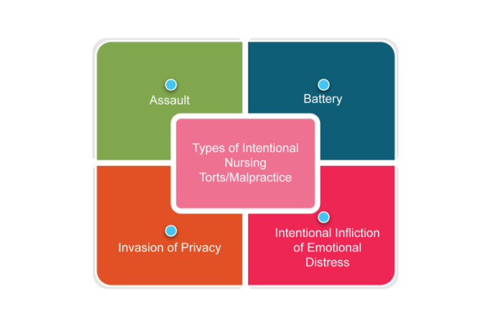
Intentional Malpractice
Notes:
Assault
Definition: Intentional threat toward another person
Examples
Threatening to give a patient an injection despite lack of consent
Threatening to restrain a patient without reason
Battery
Definition: Intentional offensive touching without consent
Examples
Giving an injection without consent
Placing restraints on a patient without reason
Invasion of Privacy
Definition: Health information is shared or images are obtained without patient consent
Examples
Sharing a patient’s medical diagnosis with a family member prior to receiving consent from the patient
Posting a picture to social media that includes patient information in the background
Intentional Infliction of Emotional Distress
Definition: The nurse’s actions are so outrageous that it leads to emotional shock of the patient
Example
In Roddy v Tanner Medical Center, 2003, the patient was discharged home after a spontaneous abortion at 10 weeks of gestation. At home, the patient discovered that the fetus was still in the bag of soiled clothes worn in the emergency department. The patient sued the hospital for emotional distress (Mahlmeister, 2017).

Slide 34
Discussion
You have a coworker that expresses deep discontent for their job and goes on a tirade on social media – what do you do?
You have nurses in the unit taking selfies at the nurses station. What issues could arise?
If you have a preceptor on your unit who gives their password to an orientee in order to allow them to chart – what would you do?
You have an employee who accesses their child’s chart, is that a problem? What if that child was 16 and seeking care for a condition parental consent is not required?
You are in the ICU and your patient is obviously not doing well and family is refusing end of life care. Thoughts? What if they overrode a previously in place advanced directive?

Slide 35
Questions?

