Slide 1
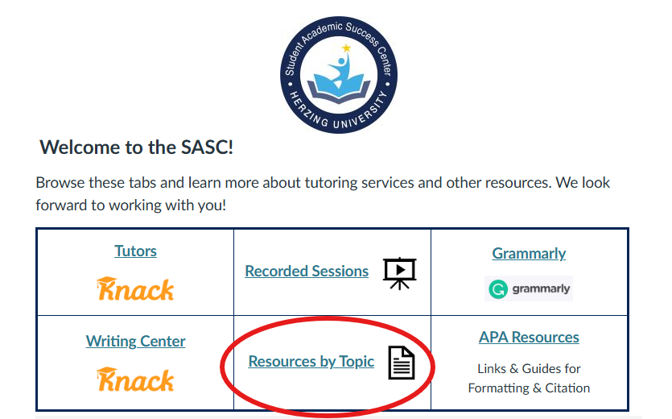
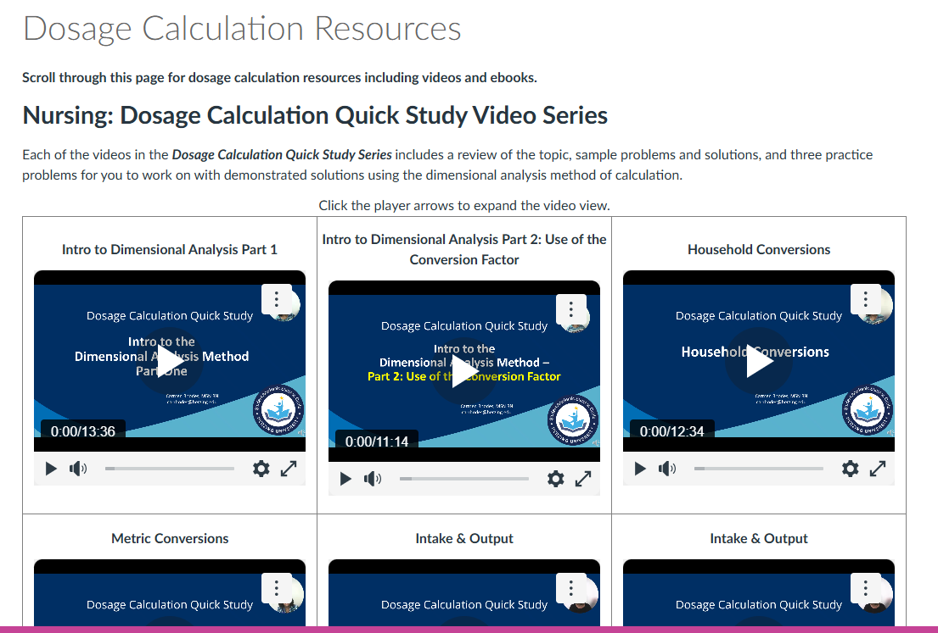
Dosage Calculation Resources
Visit the Student Academic Success Center in the Student Resource Center on your Canvas Dashboard for videos, ebooks, and more.

