Slide 1



NSG522
Class Orientation
Notes:
Reminder, if you have taken this course previously, please ensure you still go through the course as improvements have been made for student success based on feedback from past students.

Slide 2
This course provides a clinical practicum for the application of concepts learned in health assessment and fundamental nursing courses. Evidence-based practice, critical thinking, teaching/learning, professional behaviors, communication, collaboration, skills/technology, and professional development are embodied and exhibited. The student engages in the application of the nursing process in collaboration with the RN preceptor or clinical instructor, who guides the clinical experience. Semester Credit Hours: 2.00 Contact Hours: 0/30/45/75 Prerequisites: None. Corequisites: NSG 521 Fundamental Concepts and Health Assessment.

Slide 3
Communication Expectations
It is the expectation that faculty respond to students within 48 hours. If you have not received a response from your faculty during that timeframe, please reach out to Dr. Powell, course lead for NSG 522.
  Students should not be reaching out directly to Dr. Prashad. Your primary faculty is the initial point of contact.
Students are required to regularly check their Herzing University email address, as well as their announcements and Canvas messages.
  This includes any other places where communication may be sent, i.e., ELMS

Slide 4

In-Person Clinicals
Policies, Procedures & Expectations

Slide 5
Expectations
This term, you will be completing 24 in-person clinical hours at a site assigned by our clinical placement team. Once you receive your preceptor/faculty’s name and contact information, please email it to your instructor.
You are responsible for scheduling your 24 hours with your preceptor/faculty and ensuring that all hours are completed by the end of the term. Incompletes are granted only for extenuating circumstances, and those conversations must occur with me before the end of the term. If you do not meet your required hours, it constitutes a clinical failure.
When scheduling your hours, here are things to remember:
1) You can do a maximum of 40 hours a week
2) You can do a maximum of a 12-hour workday
3) You cannot schedule yourself to work a night shift and then attend clinical during the day. This would constitute an unsafe patient experience.
4) Once you receive placement, you need to start your clinical rotation promptly; do not wait several weeks to begin your assignment.
5) You must follow Herzing’s dress code policy and wear Herzing's appropriate scrubs, closed-toe, non-skid shoes, have tattoos covered, no false eyelashes, and no fake nails.
6) There is no gum chewing or eating in public/common areas such as nurses' stations.
7) There should be no cell phones on the unit. Social media policies apply.
8) Clinical attendance policy applies. Upon creating your schedule with your preceptor, the schedule needs to be emailed to your faculty member, as we are “on-call” for emergencies while you are at clinical. If that schedule changes for any reason, we need to be notified before the absence and provided with a plan to make up these hours.

Slide 6
Assignments related to In-Person Clinicals
Initial Meet and Greet: Before or on your first clinical day, we must schedule a 15-minute meeting with ourselves and your preceptor to discuss the expectations of the clinical and goal setting.
Clinical Hours Report due each week: Remember to complete and submit even if you have zero hours. Your preceptor/faculty CANNOT type their name, nor sign and draw an arrow going down the column. They need to sign each line for each submission.
Week 15, you will have an Assignment Final Clinical Paperwork. If you finish with your hours early, you can submit this form early. There is a final evaluation that your preceptor/faculty will complete on you.
Notes:
In-person faculty contact information must also be provided

Slide 7
Virtual Clinicals
Policies, Procedures & Expectations

Slide 8
Virtual Clinical Schedule
This is in addition to the Required Lab Hours. There are 5 required synchronous clinical hours for Clinical I (NSG522).
The schedule will be posted soon! Keep a lookout! ☺

Slide 9

Virtual Clinical Day Schedule
Clinical Days (listed in previous slide):
Pre-Conference – 1.5 Hour
Shadow Health Completion- 2 Hours
Post-Conference- 1.5 Hour
Completion of Shadow Health modules by 2359 days of clinical
  DCE score will automatically transfer into the gradebook.

Slide 10
Passing Score
A minimum score of 76% on the Digital Clinical Experience (DCE) Score must be achieved for each assigned scenario to meet the competency threshold.
We will not be using the Subjective Performance Indicator (SPI) score

Slide 11

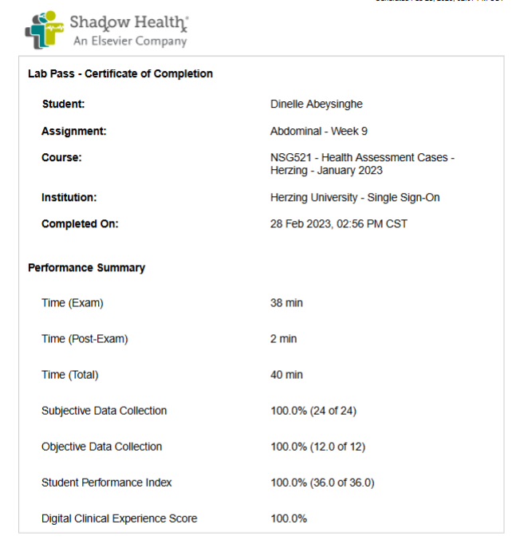

Slide 12
Clinical Activity Expectations
Zoom etiquette: please treat virtual clinical like in person clinical
  Professional background (i.e. not in bed)
  Camera expected to be on
  Minimize background noise
  Log into Zoom on time (please see attendance policy)
  Have the correct full name (first and last) in your Zoom window
  Cannot be at work, in a car, or running errands
Professional communication in all modes: follow the PRICE model
  Zoom, email
No cell phone use or searching web/social media during clinical
No food while on zoom, drinks acceptable
Expected to be available the entire clinical day (this is a BON clinical hour requirements for licensure)

Slide 13
Clinical Performance Activity Violation Policy
First “Clinical Performance Activity Violation” (handbook definition: performance in lab, simulation, clinical) = First Warning. The student will be provided a counseling session/ formal warning with documentation. This first violation of clinical performance is cumulative and may result in a course of failure if three clinical performance violations occur. The clinical portion of this course is Pass/Fail. To pass the course, a student must obtain 80% in clinical-related assignments and must pass all clinical activities. This will be documented as a Clinical Performance Activity Violation email, is not removable, and remains part of the course record.
Second “Clinical Performance Activity Violation” (handbook definition: performance in lab, simulation, clinical) = Second Warning of impending course failure if future violations occur. The student must meet with faculty within 72 hours of the violation. The student will be provided with remediation that must be completed, including acknowledgment that a third violation will result in course failure. The clinical portion of this course is Pass/Fail. To pass the course, a student must obtain 80% in clinical-related assignments and must pass all clinical activities. This will be documented as a Clinical Performance Activity Violation email, is not removable, and remains part of the course record.

Slide 14
Clinical Performance Activity Violation Policy (continued)
Third “Clinical Performance Activity Violation” = course failure. A Clinical Performance Violation may include:
  Tardiness (0 to 14 minutes late)
  No Call/No Show (15 minutes or more tardy for the clinical day or not showing up with appropriate notification)
    Students who arrive 15 minutes after the start of the clinical day will be allowed to participate, but will not receive credit for the hours
    The extenuating circumstance policy applies to both the NCNS and 15 minutes or greater tardiness.
  Being unprepared for the clinical experience, including not having the required coursework completed
  Not meeting dress code standards for the clinical experience.
  Not attending the entire shift of the clinical, including the last day of clinical.
  Demonstrating unsafe behaviors (refer to handbooks and catalog).
  Delivering unsafe care to assigned patient(s)/client(s) (Refer to catalog and handbook).
  Exhibiting inappropriate or unprofessional behaviors.
  Not adhering to recommendations, policies, standards, or expectations of the facility or Herzing University.
  *Please note that all missed clinical time must be made up. Please review the extenuating circumstances policy since documentation may be needed for clinical make-up

Slide 15

Assignment Expectations
Weekly Assignments
  Every student will submit complete clinical assignments on the assigned due date, as indicated by the clinical instructor.
  Please review the Modules if there are any questions regarding due dates.

Slide 16
High-Fidelity Simulation
Notes:
High-fidelity simulation uses advanced technology, like lifelike computerized mannequins or virtual reality, to create extremely realistic, complex, and immersive training scenarios, primarily in healthcare, that mirror real-world situations, allowing learners to practice critical skills and decision-making in a safe environment to reduce errors and build competence

Slide 17
High Fidelity Simulation Patients
During this term’s intensives, you will be participating in several simulation events. In preparation, there is required asynchronous coursework to complete in advance. All preparatory assignments must be submitted by 11:59 PM CST on Sunday, January 18th, 2026.
The Student Guides and subsequent quizzes can be found in Canvas<<<Read Me First<<<Simulation Activities and Resources.
  Fundamentals Carmen Price Infection Control
  Fundamentals Carmen Price Safety
  Fundamentals Marcus Price Focused Assessment
  Fundamentals Marcus Price Pain Management
  Fundamentals Sun Ja Lim Patient Fall
  Fundamentals Tanya Ortiz NG Med Administration
  Fundamentals Tanya Ortiz IV Infiltration
  Fundamentals Tanya Ortiz Ostomy
Failure to complete the required simulation hours and ineligibility for attending Intensives are the students' responsibility.

Slide 18
Lab
Notes:
The lab component will be completed during Intensives.

Slide 19
Lab Quizzes
Please complete the quiz found in your canvas module
You need an 80% to pass
You have 3 attempts to complete this quiz
If you are still unsuccessful after the SECOND attempt, please reach out to your lab instructor for assistance.
You must pass this quiz PRIOR to coming to lab. This is your ticket to validate
  You will NOT be allowed to validate if this is not completed prior to class
  This will also count as your first attempt for the skills validation

Slide 20
Intensive 1
HU Intensive #1 Info

Slide 21
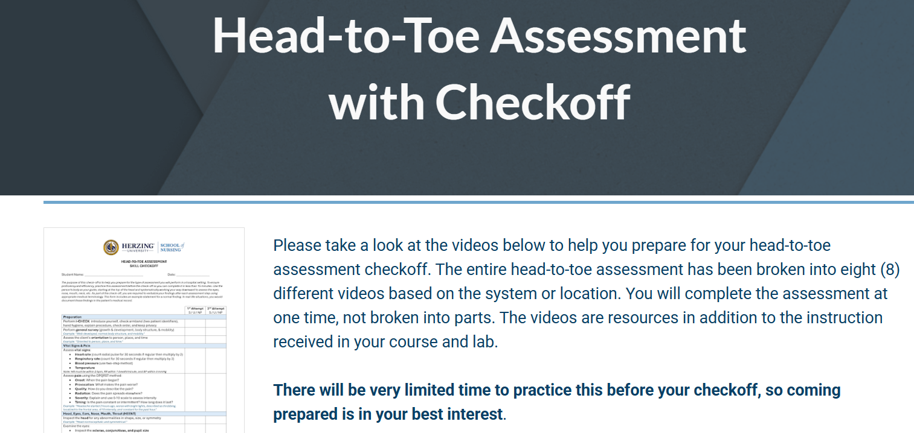

Slide 22
Attendance
Attendance is mandatory for all sessions, and punctuality is crucial
Sessions begin promptly at 7:30 am CST each day!
Check in daily at the Intensive table to ensure you receive any required documents (checkoff forms) and information, and that your hours are credited.
Plan to stay until 6 pm CST each day. Do not schedule a flight too early on your last day; again, you must stay until intensives are complete

Slide 23
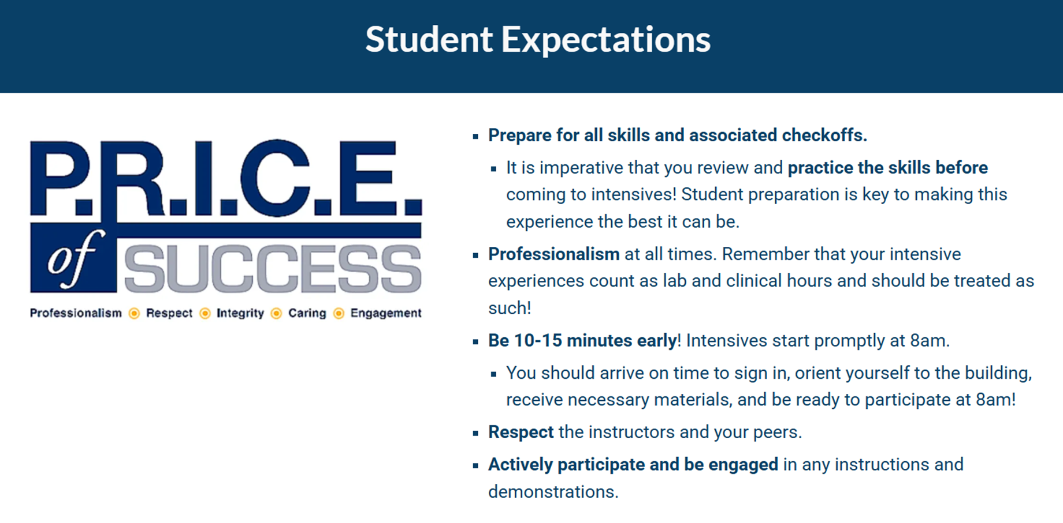
Notes:
**7:30 am CST

Slide 24
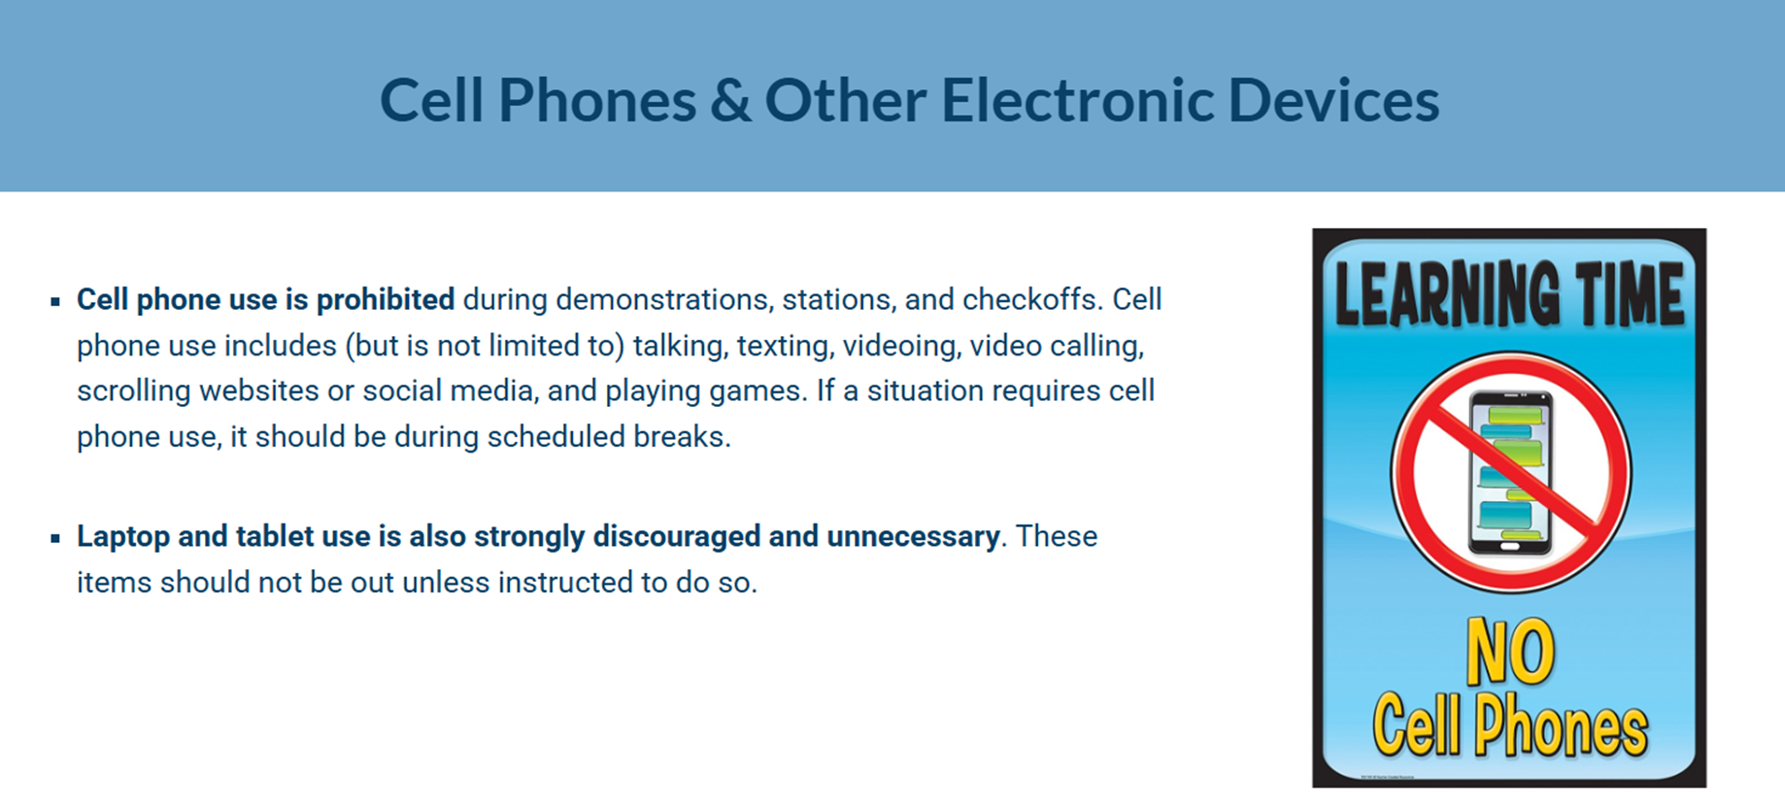

Slide 25
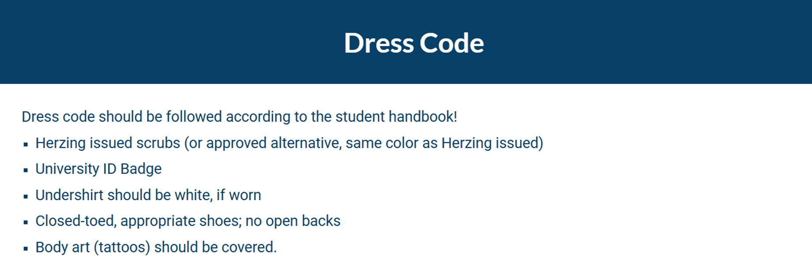
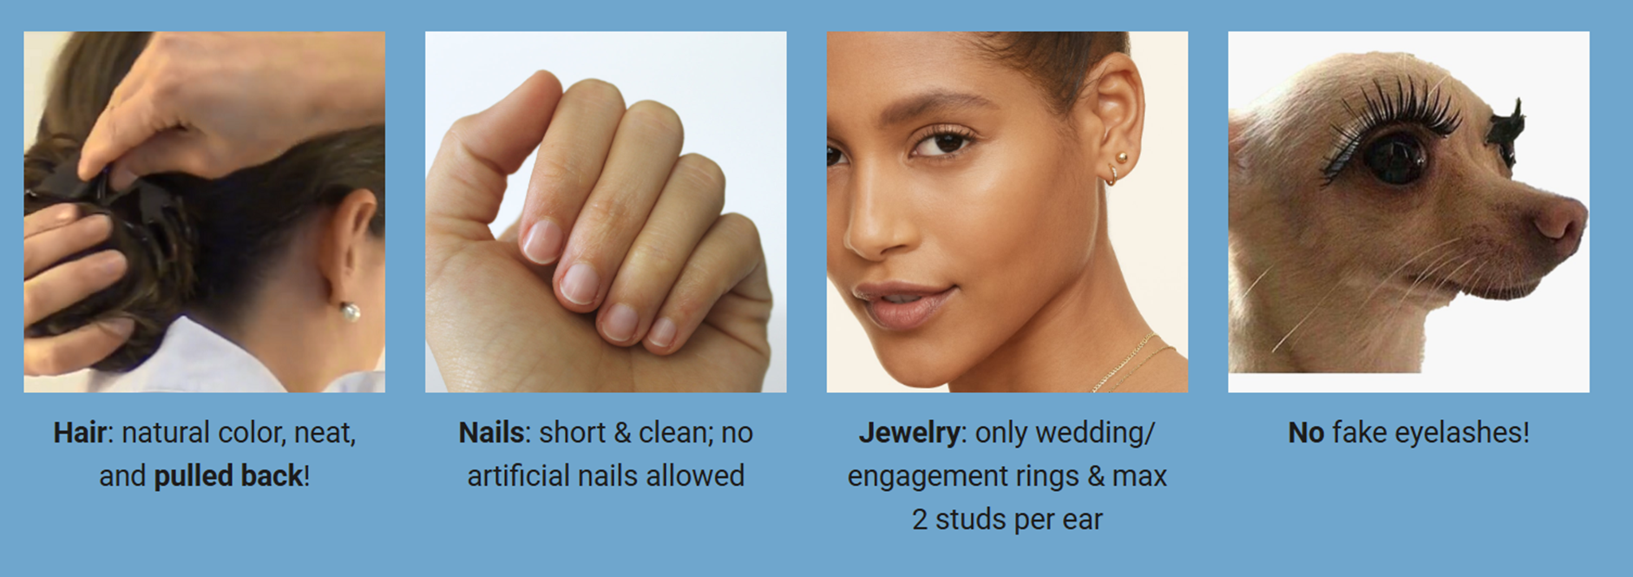

Slide 26
CORE ELMS
All placements, including clinical and intensives, will be placed into ELMS and can be viewed in each student’s calendar.
All hours relating to lab, clinicals, and intensives must be uploaded into ELMS by the students for approval.
If a student has a schedule change and received placement previously, their schedule automatically gets archived.

